Slide 1
Dungeon Organizer
By
The Gnolls
Presenter: Russell
Notes:
Russell

Slide 2
Team Members
Jacqueline Munroe - Project Lead
Michael Dunton - Scrum Master
Toyanne Bennett - Documentation
Widler Rislin - Database Programmer
Russell Stephenson - Programmer
Notes:
Russell

Slide 3
Project Description
Development of an interactive website for players of Dungeons & Dragons 3.5, that allows for:
Creation/Management of Character Sheets
Searching for spells, items, races, classes, feats, etc.
Creation of Parties Comprised of a Dungeon Master (DM) and Players
Conversation and Long-Distance Play via a Bulletin Board

Slide 4
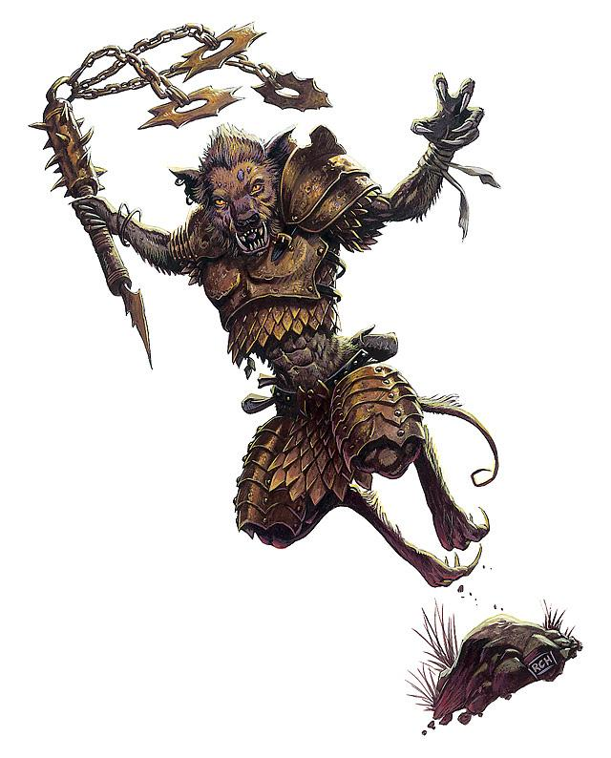
Collaboration
Github
https://github.com/gnolls/Yeenoghu

Slide 5
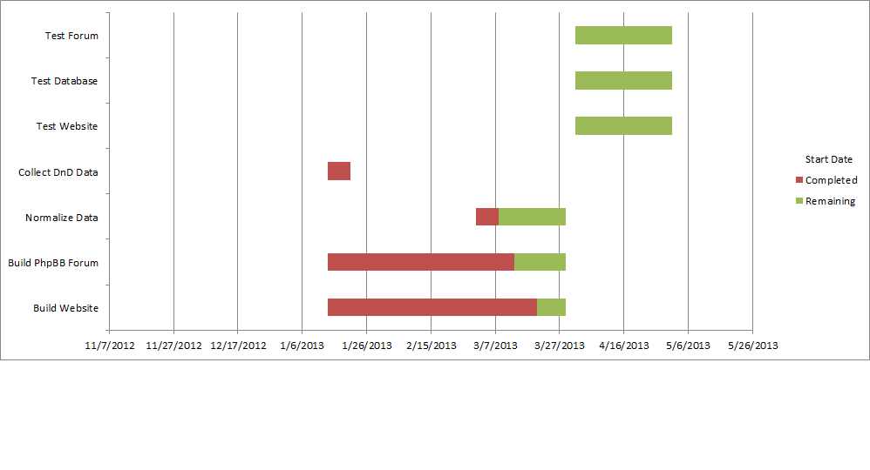
Schedule

Slide 6
This Week's Accomplishments
Meeting 3/20/2013
Change tuples for easier population of the database
Began writing algorithm to populate the database
Worked on the website and php board

Slide 7
Next week
Make the website and forum look nice
Organize the forum into sections
Hopefully populate the database

Slide 8
Expended cost to date
6 Hours (@ $37.50/hr)
$2475
Server Costs
$60/year + $9.95 for domain name.
Running Total
$2544.95

Slide 9
Issues not resolved
After rearranging the tuples the sorting of the spells, abilities, etc. will not be as refined as we would like

